Slide 1
Quant
2024-2025
Hack Night 5/6 10/24/24

Slide 2
Agenda
Announcements
https://tinyurl.com/bdhapskd ← fill this out if you haven’t!
Ice breakers
Probability
Options
Projects

Slide 3
No Hack Night Next Week, October 31st
TBD Social event in place of Hack Night!

Slide 4
Probability

Slide 5
Options

Slide 6
What is an Option?
An option is the right to buy or sell an asset at a later date
Started in the agriculture industry, was a way to hedge risks
2 Main types:
Calls:
Right to buy an asset at a later date
Puts:
Right to sell an asset at a later date

Slide 7
Calls
Right to buy an asset at a later date
Pay a premium to lock in a price at a future date
Can buy (long) or sell (short)
The buyer of the option has the option to buy the asset. The seller cannot choose whether to sell, they must sell if and only if the buyer decides to buy

Slide 8
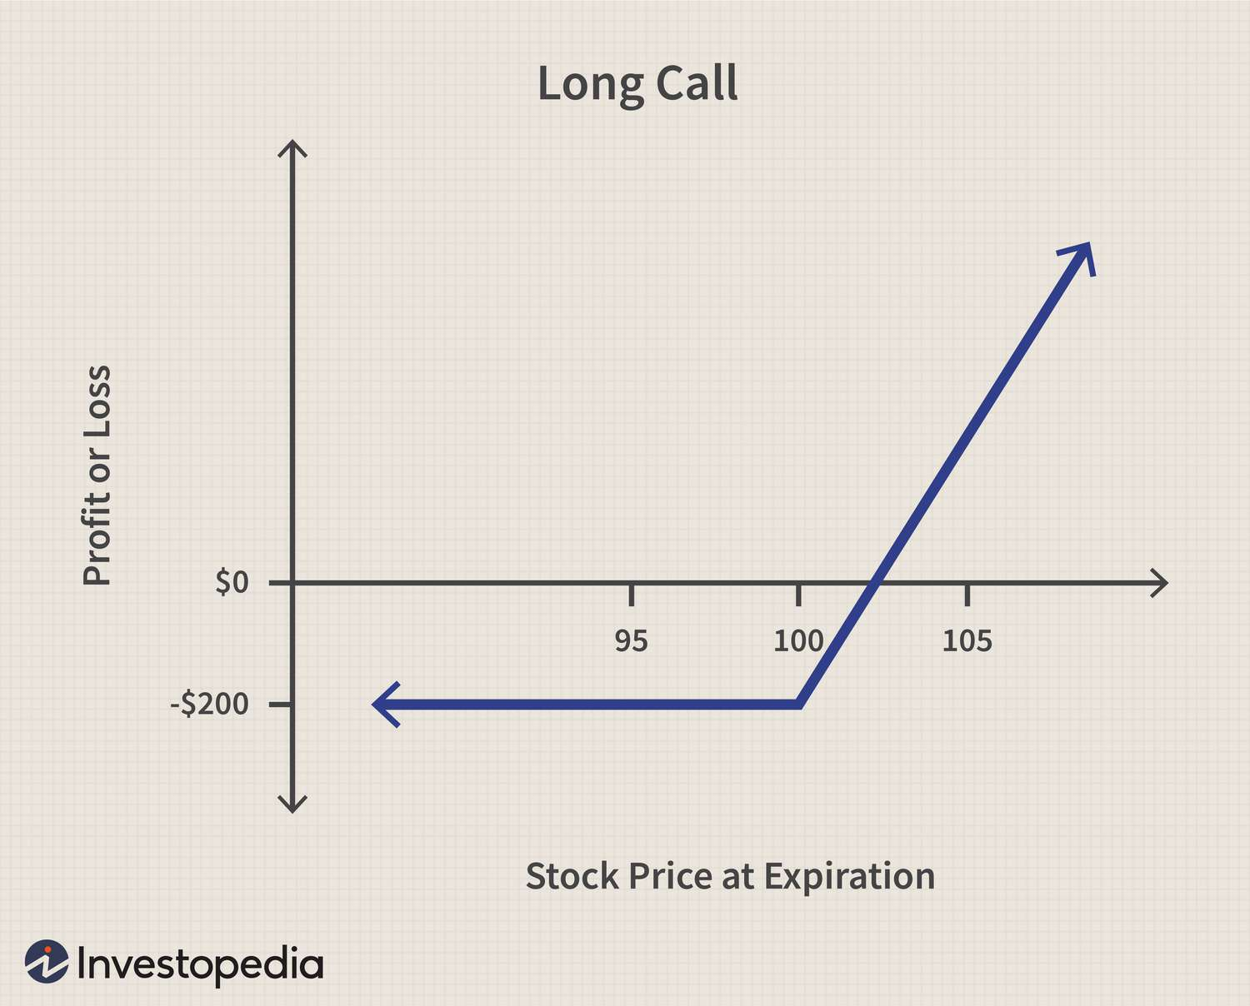

Slide 9
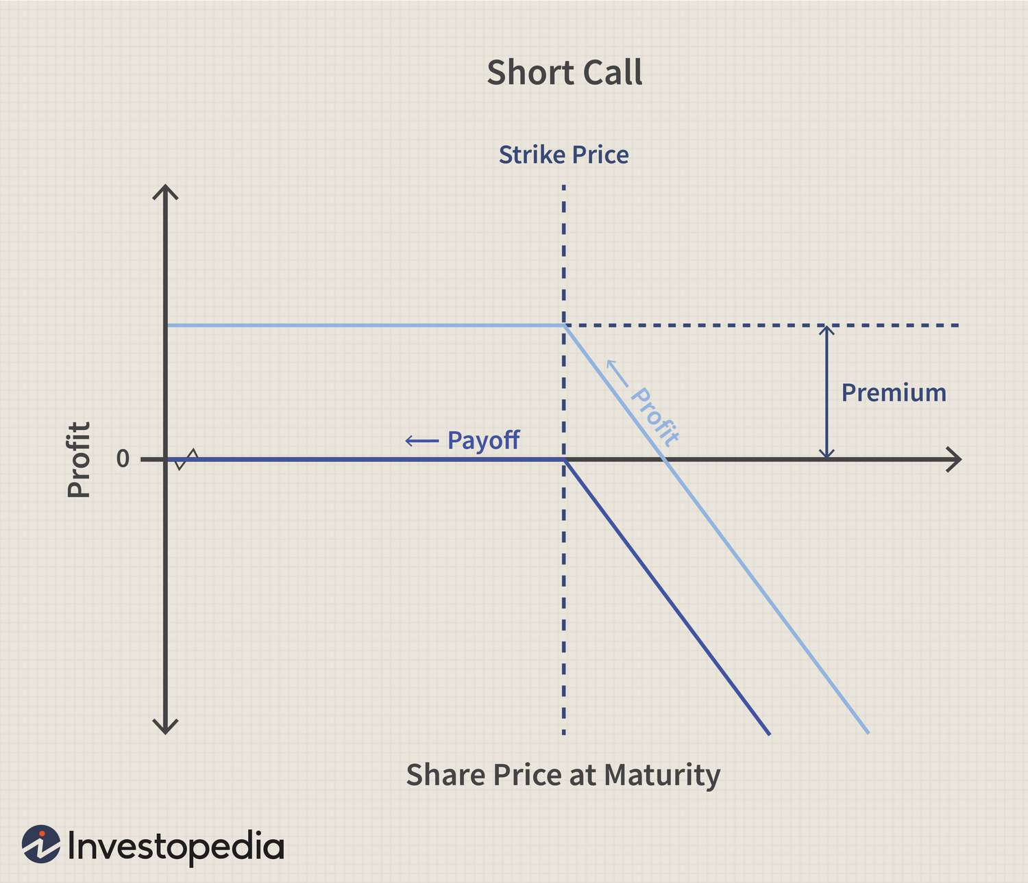

Slide 10
Puts
Right to sell an asset at a later date
Pay a premium to lock in a price at a future date
Can buy (long) or sell (short)
The buyer of the option has the option to sell the asset. The buyer of the asset cannot choose whether to buy, they must buy if and only if the seller decides to sell

Slide 11
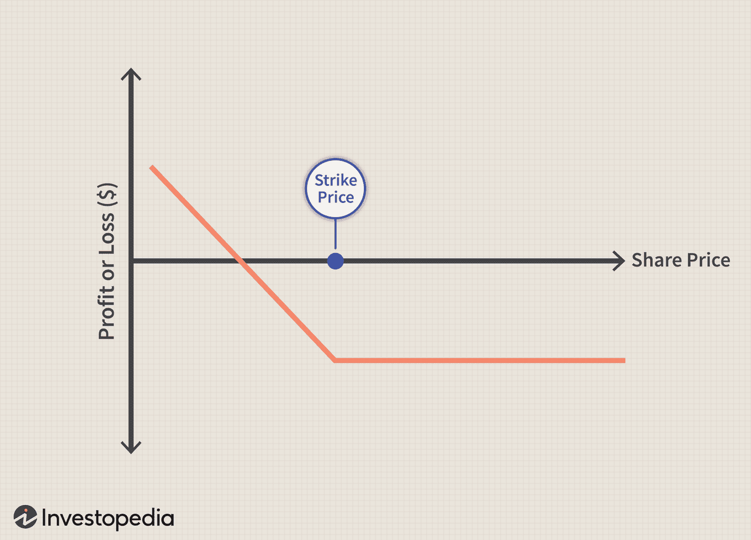

Slide 12
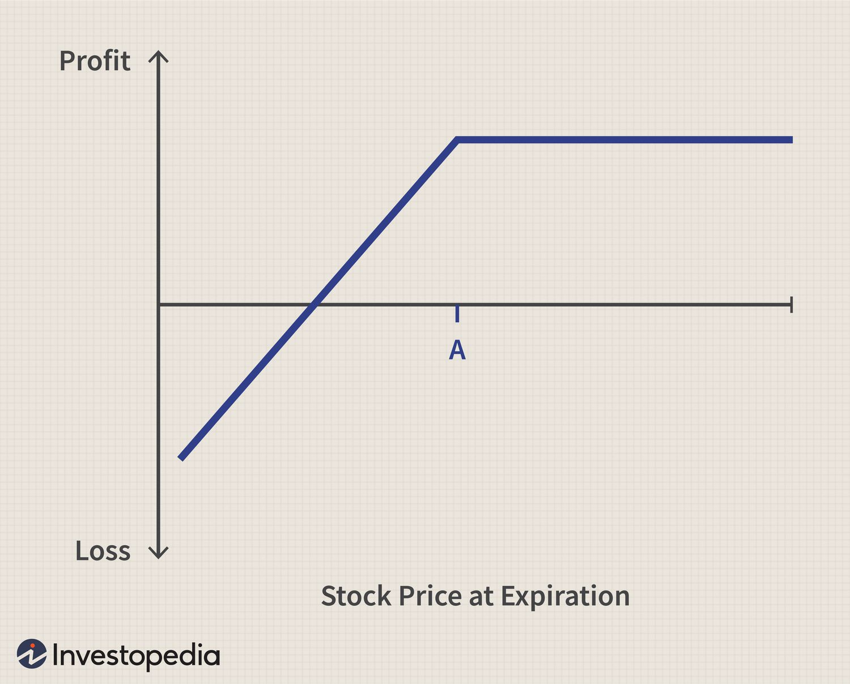

Slide 13
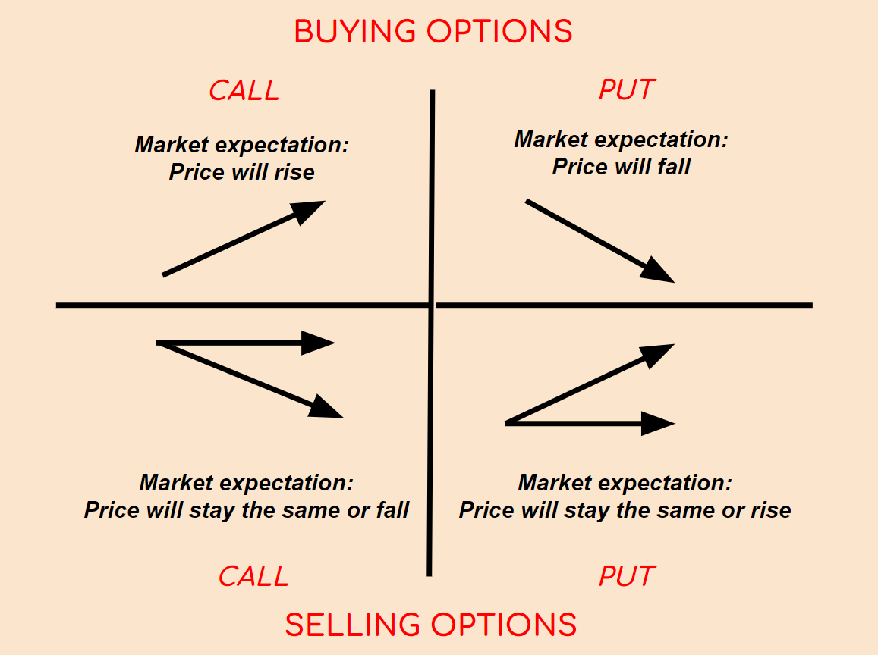
Simtrade, Luis Ramirez

Slide 14
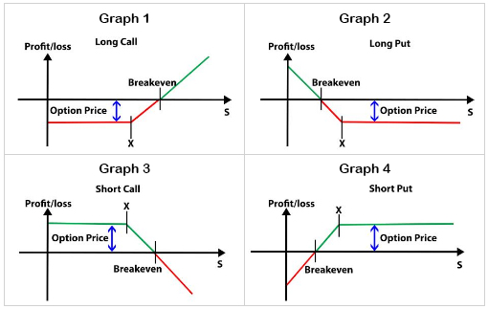
Risk of Options
Options are very risky
Shorting a Call has unlimited downside risk
Shorting a Put can cost the entire price of the stock minus the price of the option
Long Calls have unlimited upside risk
Long Puts can lead to gains of the entire price of the stock minus the price of the option
Note: you are in control when buying options. You can only lose the premium paid if done right.
quantra

Slide 15
Other options info
American vs European Options:
American options can be exercised at any point up until the expiration date
European options can only be exercised on the expiration date

Slide 16
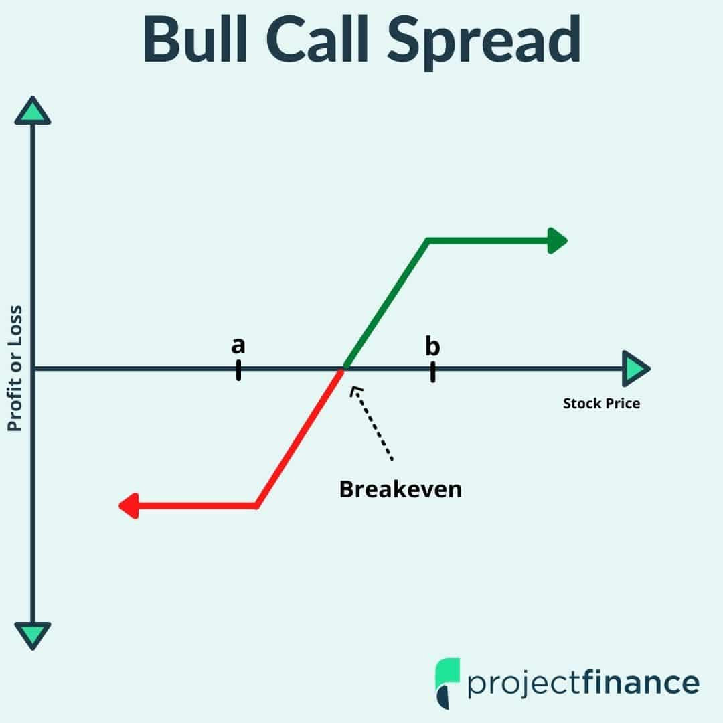
Cool things you can do
Combine these types!
Which 2 types are combined here?
Buy a call at price a
Sell a call at price b

Slide 17
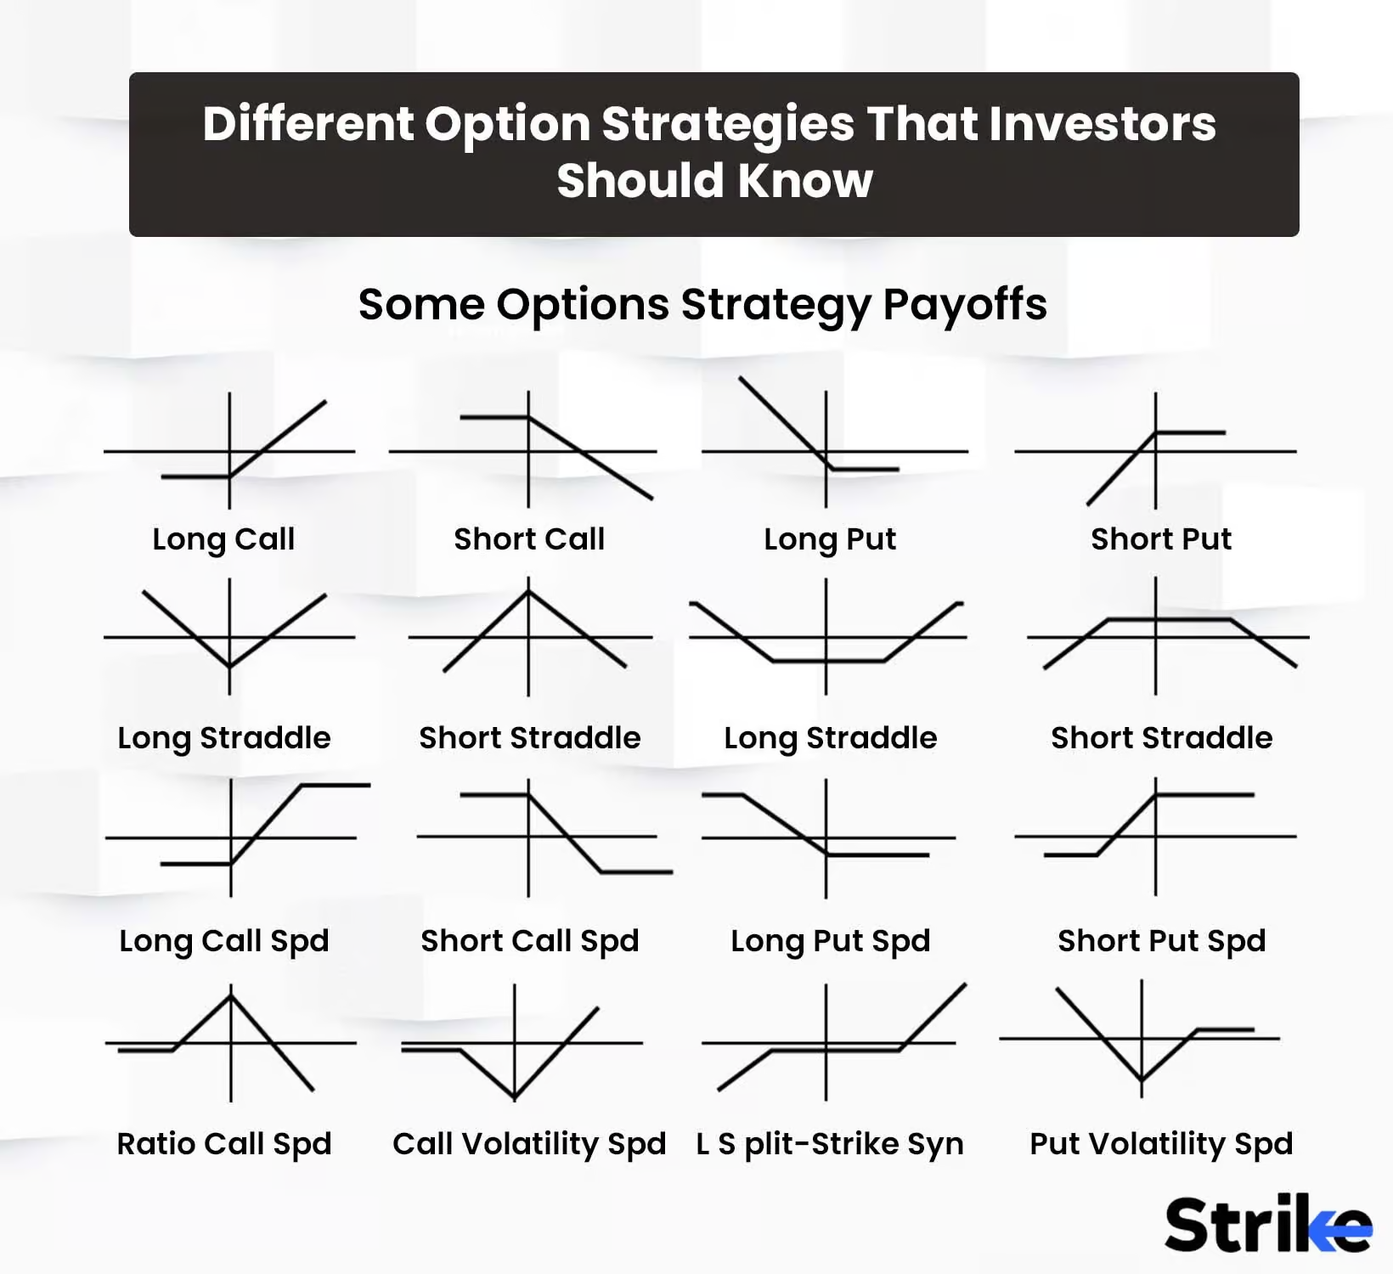

Slide 18
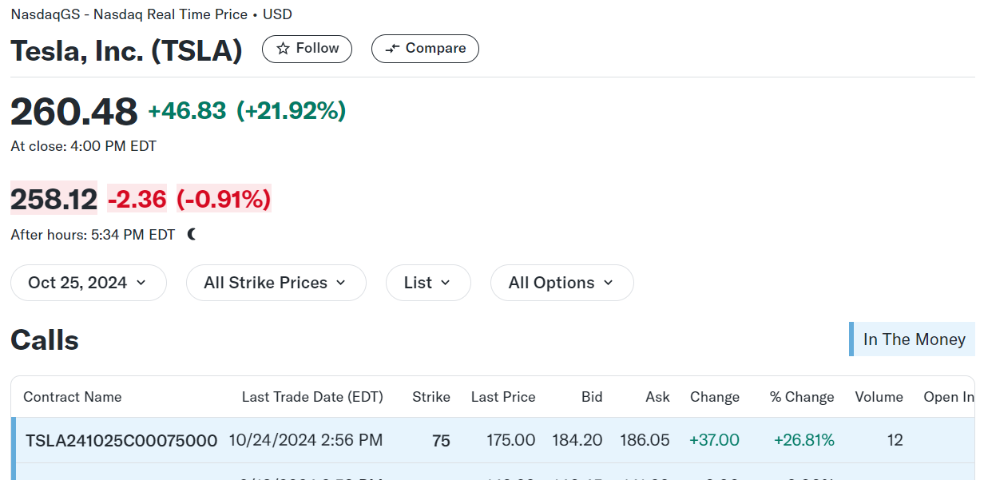

Slide 19
Projects

Slide 20
Stock Market Simulator
Take in orders in the format <ticker> <buy_or_sell> <quantity> <order_type> <price> <time>
Output the transactions <ticker> <quantity> <price> <time>
Language: Any
Advanced Options:
Print out order book n prices deep
Dark Pools & Orders!
Able to take in complex order types
Anything else you can think of!

Slide 21
Figgie/Poker Game Theory
Poker Theory-esque strategy
Calculate best strategies based on your information and your opponent’s perceived information
Advanced Options:
Greater than 2 players
Anything else!

Slide 22
Implement Trading Strategy
Possible continuation from last semester’s project.
Possible Trading Strategies to Implement:
Pairs Trading
Relative Strength Index (RSI)
Anything else!
Advanced Options:
Use Sharpe ratio to calculate optimal bundle of goods
(Will talk about sharpe ratio more next week)

